Slide 1
Part I
Elementary Statistical Methods
Data Collection

Slide 2
Elementary Statistical Methods
Chapter 1
Data Collection
Slides are Made by
Tamer Oraby
UTRGV

Slide 3
Outline:
Very brief introduction to data collection
Population vs sample
Types of samples
Parameter vs statistic
Types of variables: quantitative vs qualitative
Types of quantitative variables: discrete vs continuous
Types of qualitative variables: nominal vs ordinal

Slide 4
Data
Statistics
collect
organize
summarize
analyze
To draw a conclusion
with a degree of confidence.

Slide 5
Statistics
Descriptive statistics
Organizing, summarizing and presentation of data
Inferential statistics
Methods to analyze data to draw conclusion and assess their reliability with a certain level of confidence. It includes estimation and test of hypotheses.

Slide 6
How do we COLLECT data?

Slide 7
Population
Sample
Sample size is
denoted by n
Population size is
denoted by N
Population: a collection or a group of individuals or items.
Populations are finite or infinite (very large).
Sample: a sub-collection of population.

Slide 8
Population
Sample
Sample size is
denoted by n
Population size is
denoted by N
Statistic: numerical
summary of sample.
We usually use Latin letters to denote
statistics, like
$$\overline{x}, s, p$$
Parameter: numerical
summary of population.
We usually use Greek letters to denote parameters, like
$$μ, σ, ρ$$

Slide 9
What are the types of samples?

Slide 10
Convenience Sample: a sample whose elements are selected without a system or haphazardly. It can lead to biased conclusions.
Convenient Sample of size n=5
Population
Those 5 subjects might haven been selected because they are the first students showing up to the class or sitting down in the front row.

Slide 11
Simple Random Sample (SRS): a sample whose elements are selected randomly from a population such that any two samples of the same size (n) have the same probability to be selected.
Random Sample of size n=5
Population

Slide 12
Simple Random Sample (SRS): a sample whose elements are selected randomly from a population such that any two samples of the same size (n) have the same probability to be selected.
Random sample of size n=5
Population
Another random sample of size n=5
If random samples of same size n have the same probability to be selected, then they are SRS.
That is both are equally likely to occur.

Slide 13
How to select a random sample?
Make a sampling frame using with labeling of individuals in the population by
1, 2, 3, …, N
2. Use a random table, a random sampling function in a software like R
or TI-calculator to sample n labels between the lower label =1 and the
upper label = N
3. Random sampling or selection must be done “without repetition/replacement.”

Slide 14
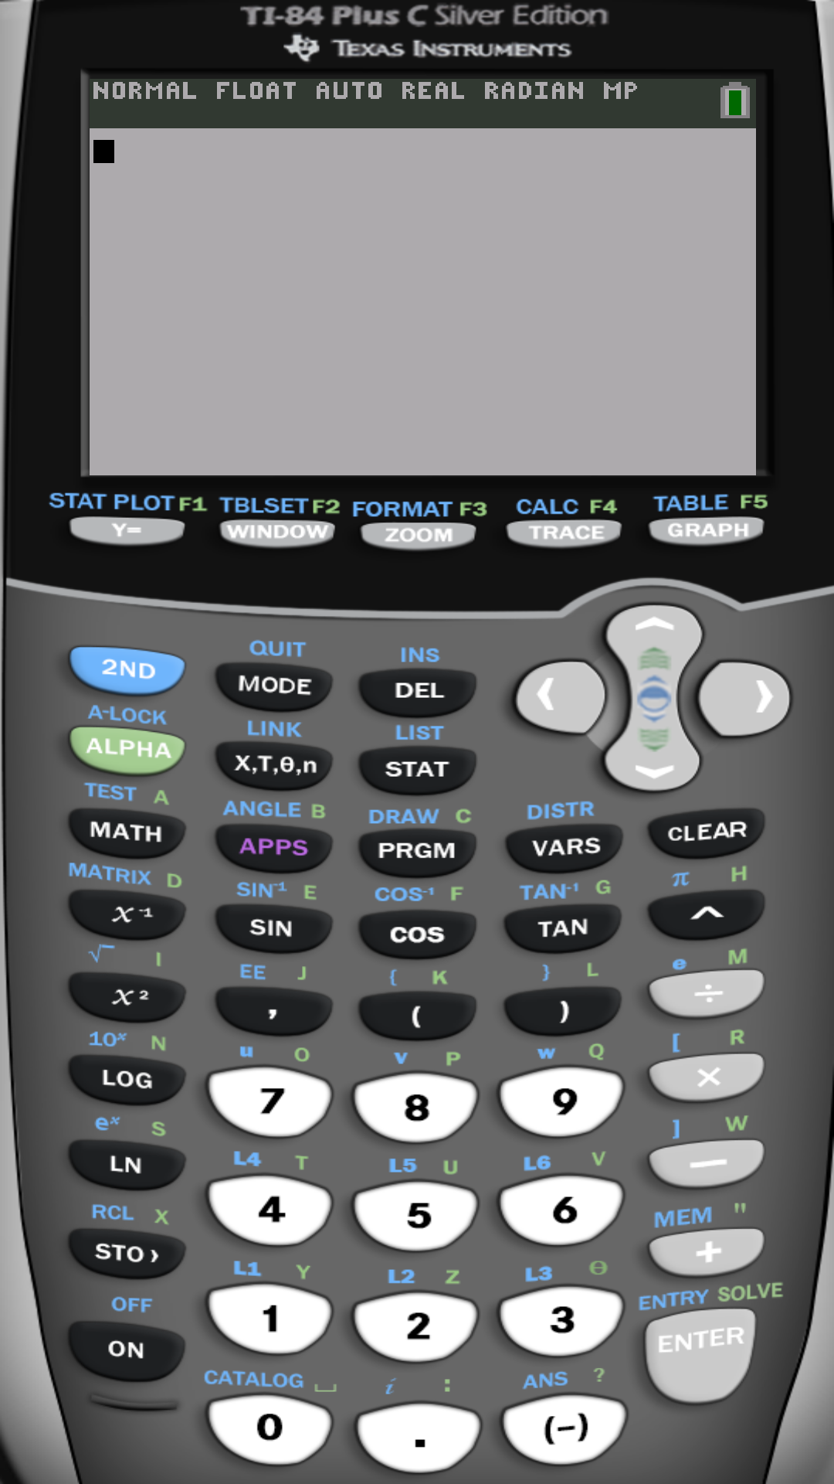
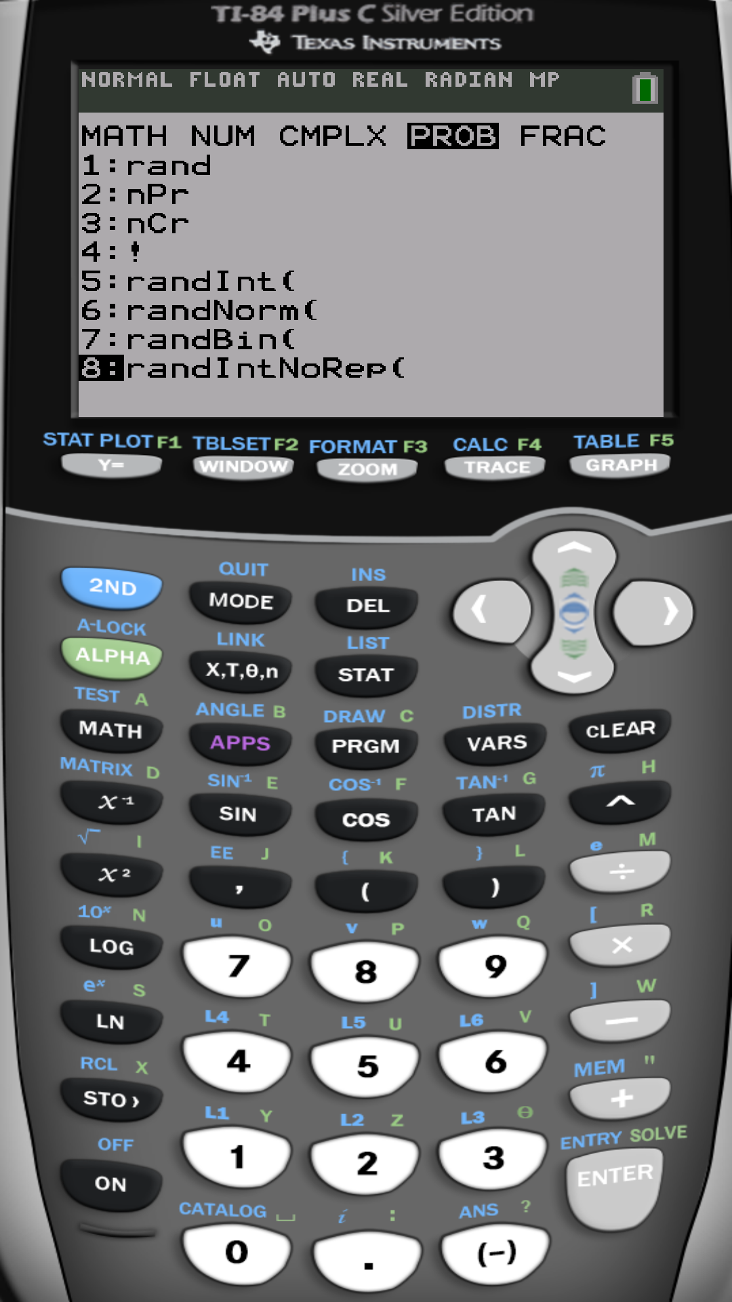

Slide 15
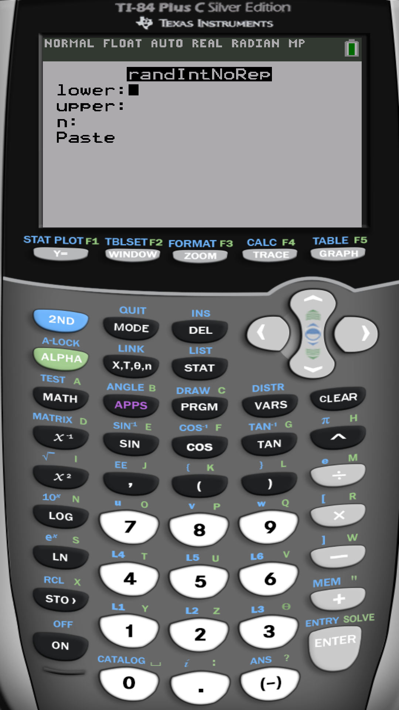

Slide 16
Example: To select a random sample of size n=5 from a population of size N=80, label the population’s individuals
1, 2, …, 80. Then use the
TI-calculator …

Slide 17
Example: To select a random sample of size n=5 from a population of size N=80, label the population’s individuals
1, 2, …, 80. Then use the
TI-calculator …
Notice that every time you run this function you get a different answer, since the n=5 labels are generated randomly

Slide 18
You can also store the result into a list
Like L1

Slide 19
On some calculators you would do:
randIntNoRep(80,5) instead of randIntNoRep(1,80,5)

Slide 20
Other types of samples…

Slide 21
Systematic Sample (SyS): a sample whose elements are selected every k^{th} member of the population.
Like selecting every 3rd member till getting 5 of them.
Population

Slide 22
Stratified Sample (SS): a sample comprised of (r) SRSs each of which is selected from one of r sub-populations (called stratum). Strata are formed according to some characteristics relevant to the study; like, gender, college, etc.
Population
Stratified Sample of size n=5
Female (Stratum 1)
Male (Stratum 2)

Slide 23
Cluster Sample (CS): a random sample of sections of the population of which all members are included in the sample.
Population divided into 9 sections
Cluster Sample of 2 clusters

Slide 24
But there are still some errors …
Sampling error: difference between results of the sample and the actual parameter values in the population.
Non-sampling error: happens when using the uncalibrated instruments to take measurements or using poorly formulated questions in surveys.

Slide 25
Data for the selected individuals (subjects), or in general
observational units, is made from a number of variables.
And variables are …

Slide 26
Variable
″a characteristic of individuals or items″
Quantitative
(numerical)
Qualitative
(categorical)
- Numbers to describe individuals
- Can be added or subtracted
- Classification of individuals
based on attributes
Examples:
- Age : 16, 18, 20
- Height: 5′5″, 5′3″, …
- Numbers of patients: 1, 2, 3
Examples:
- Gender: M, F
- Birthplace: Edinburg, McAllen
- Letter grade: A, B, C, D, F
ID number,
Phone number,
Zip code
Time

Slide 27
Variable
″a characteristic of individuals or items″
Quantitative
(numerical)
Qualitative
(categorical)
Discrete
″countable″
Continuous
″uncountable″
Nominal
Names, labels
Ordinal
Can be arranged or ranked
Example:
Number of people
0, 1, 2,…, 30
Example:
Time to finish a task
Example:
Birthplace
Example:
Letter grades,
Military ranks

Slide 28
Which variables should we select?

Slide 29
Research Plan:
Identify the question/objective (plan),
Determine population, the sampling procedure, and the variables that answer the question (e.g. blood pressure, gender, etc.).
Collect data (measure of blood pressure, record gender, …).
Summarize data using graphs and statistics.
Inference about data to reach an answer to the question.

Slide 30
Example :
Smoker’s IQ A study was conducted in which 20,211 18-yearold Israeli male military recruits were given an exam to measure IQ. In addition, the recruits were asked to disclose their smoking status. An individual was considered a smoker if he smoked at least one cigarette per day. The goal of the study was to determine whether adolescents aged 18 to 21 who smoke have a lower IQ than nonsmokers. It was found that the average IQ of the smokers was 94, while the average IQ of the nonsmokers was 101. The researchers concluded that lower IQ individuals are more likely to choose to smoke, not that smoking makes people less intelligent. Pg.13
(a) What is the research objective?
To determine relationship between smoking and cognitive tests (IQ).
(b) What is the population being studied? What is the sample?
Adolescents aged 18–21; the 20,211 18-year-old Israeli male military recruits.
(c) What are the descriptive statistics?
The average IQ of smokers was 94; the average IQ of nonsmokers was 101.
(d) What are the conclusions of the study?
Lower IQ individuals are more likely to choose to smoke.

Slide 31
Example :
Government Waste Gallup News Service conducted a survey of 1026 American adults aged 18 years or older, August 31–September 2, 2009. The respondents were asked, “Of every tax dollar that goes to the federal government in Washington, D.C., how many cents of each dollar would you say are wasted?” Of the 1026 individuals surveyed, 35% indicated that 51 cents or more is wasted. Gallup reported that 35% of all adult Americans 18 years or older believe the federal government wastes at least 51 cents of each dollar spent, with a margin of error of 4% and a 95% level of confidence.
(a) What is the research objective?
To determine the proportion of adult Americans who believe the federal government wastes 51 cents or more of every dollar
American adults aged 18 years or older
(b) What is the population ?
(c) What is the sample?
1026 American adults aged 18 years or older
(d) List the descriptive statistics?
Of the 1026 individuals surveyed, 35% indicated that 51 cents or more is wasted.

Slide 32
Example :
Government Waste Gallup News Service conducted a survey of 1026 American adults aged 18 years or older, August 31–September 2, 2009. The respondents were asked, “Of every tax dollar that goes to the federal government in Washington, D.C., how many cents of each dollar would you say are wasted?” Of the 1026 individuals surveyed, 35% indicated that 51 cents or more is wasted. Gallup reported that 35% of all adult Americans 18 years or older believe the federal government wastes at least 51 cents of each dollar spent, with a margin of error of 4% and a 95% level of confidence.
(e) What can be inferred from this survey?
There is 95% chance that the actual proportion is between
35%$−$4% and 35%+4% which is given by the interval (31%, 39%)
Remark: The rule is that the interval is from
statistic$−$margin of error to statistic+margin of error

Slide 33
Example :
Classify the variable as qualitative or quantitative:
15. Nation of origin
Qualitative
17. Grams of carbohydrates in doughnut
Quantitative
19. Number of unpopped kernels in a bag of ACT microwave popcorn
Quantitative
21. Phone number
Qualitative (they describe a contact, we don’t add or subtract them)

Slide 34
Example :
Determine whether the quantitative variable is discrete or continuous:
23. Goals scored in a season by soccer player
Discrete
25. Length of a country song
Continuous
27. Temperature on a randomly selected day in Memphis
Continuous
29. Points scored in an NCAA basketball game
Discrete

Slide 35
Example :
Determine the level of measurement of each variable:
31. Nation of origin
Nominal
32. Movie rating of one star through five stars
Ordinal
36. Eye color
Nominal

Slide 36
Example :
Identify the individuals, variables, and data corresponding to the variables. Determine whether each variable is qualitative, continuous or discrete:
Model | Weight (ounces) | Service provider | Depth (inches)
Motorola Droid X | 5.47 | Verizon | 0.39
Motorola Droid 2 | 5.96 | Verizon | 0.53
Apple iphone 4 | 4.8 | ATT | 0.37
Samsung Epic 4G | 5.5 | Sprint | 0.6
Samsung captivate | 4.5 | ATT | 0.39
Individual | Model | Qualitative , nominal
Variables | Weight | Quantitative, continuous
 | Service provider | Qualitative , nominal
 | Depth | Quantitative, continuous

Slide 37
Example :
Driver’s License Laws The following data represent driver’s license
laws for various states
State | Minimum age for driver’s license | Mandatory belt seating position | Maximum allowable speed limit
Alabama | 17 | Front | 70
Colorado | 17 | Front | 75
Indiana | 18 | All | 70
North Carolina | 16 | All | 70
Wisconsin | 18 | All | 65
Individuals | State | Qualitative , nominal
Variables | Minimum age for driver’s license | Quantitative, continuous
 | Mandatory belt seating position | Qualitative , nominal
 | Maximum allowable speed limit | Quantitative, continuous

Slide 38
Using the statistical software R
R is a free professional statistical software
Download and install for free from
https://www.r-project.org/
Free on-line R compiler
http://rextester.com/l/r_online_compiler

Slide 39
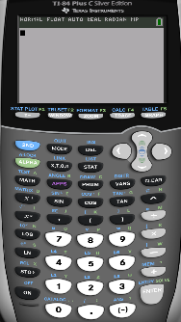
Example: To select a random sample of size n=5 from a population
of size N=80, label the population individuals
1, 2, …, 80. Then …
randIntNoRep(1,80,5) Or randIntNoRep(80,5) | sample(1:80,5)

Slide 40
End of Chapter 1

